Slide 1
Single Spin Asymmetries in High Energy QCD
Yuri Kovchegov
The Ohio State University
based on arXiv:1201.5890 [hep-ph] with Matthew Sievert
(special thanks to Michael Lisa)

Slide 2
Outline
Introduction (STSAs, saturation/CGC)
Calculation of STSA in CGC
Properties of the obtained result
Conclusions and outlook

Slide 3
Introduction

Slide 4
Single Transverse Spin Asymmetry
Consider polarized proton scattering on an unpolarized proton or nucleus.
Single Transverse Spin Asymmetry (STSA) is defined by

Slide 5
STSA: the data
The asymmetry is non-zero, and is an increasing function of Feynman-x of the polarized proton:
Fermilab
E581 & E704
collaborations
1991

Slide 6
STSA: the data
STSA is also a non-monotonic function of transverse momentum p_{T}, which has zeroes (nodes), where its sign changes:
RHIC,
STAR collaboration
2008

Slide 7
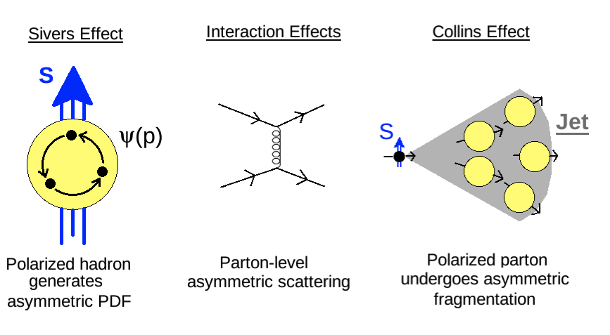
Theoretical Explanations
The origin of STSA (in the collinear factorization framework) is in
polarized PDF (Sivers effect)
polarized fragmentation (Collins effect)
hard scattering

Slide 8
High Energy QCD: saturation physics
Saturation physics is based on the existence of a large internal momentum scale Q_{S} which grows with both energy s and nuclear atomic number A
such that
and we can calculate total cross sections, particle spectra and multiplicities, etc, from first principles.
Bottom line: everything is considered perturbative.

Slide 9
Map of High Energy QCD
Saturation physics allows us
to study regions of high
parton density in the small
coupling regime, where
calculations are still
under control!
(or p_{T}²)
Transition to saturation region is
characterized by the saturation scale

Slide 10
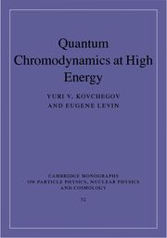
A reference
Coming in August 2012
from Cambridge U Press

Slide 11
Calculation of STSA in CGC

Slide 12
Forward quark production
It is easier to work in transverse coordinate space:
The quark (transverse) coordinates are different on two sides of the cut!

Slide 13
Forward quark production
The eikonal quark propagator is given by the Wilson line
with the light cone coordinates

Slide 14
Forward quark production
Gelis, Jalilian ‘02
The amplitude squared is
The quark dipole scattering amplitude is
Hence quark production is related to the dipole amplitude! Valid both in the quasi-classical Glauber-Mueller/McLerran-Venugopalan multiple-rescattering approximation and for the LLA small-x evolution (BFKL/BK/JIMWLK).

Slide 15
Spin-dependent quark production
The eikonal quark production is indeed spin-independent, and hence can not generate STSA.
Simple recoil, while spin-dependent, is suppressed by 1/s:

Slide 16
Spin-dependent quark production
The only way to include spin dependence without 1/s suppression
is through the splitting in the projectile before or after
the collision with the target:
Let’s calculate the corresponding quark production cross section,
find its spin-dependent part, and see if it gives an STSA.

Slide 17
Production Cross Section
Squaring the amplitude we get the following diagrams
contributing to the production cross section:

Slide 18
Extracting STSA
STSA can be thought of as the term proportional to
To get a k_{T}-odd part of the cross section
we need the anti-symmetric part of the integrand.
This may either come from the wave function squared or from the interaction with the target.
Our LO wave function is symmetric: need to find the anti-symmetric interaction!

Slide 19
C-even and C-odd dipoles
To find the anti-symmetric interaction we decompose the dipole amplitude into real symmetric (C-even) and imaginary anti-symmetric (C-odd) parts:
The symmetric part is
The anti-symmetric part is
As interchanges quark and antiquark, it is C-parity!

Slide 20
C-even and C-odd dipoles
S_{xy} is the usual C-even dipole amplitude, to be found from the BK equation
O_{xy} is the C-odd odderon exchange amplitude, obeying a different evolution equation (Yu.K., Szymanowski, Wallon ‘03)
At LO the odderon is a 3-gluon exchange:
The intercept of the odderon is zero (Bartels, Lipatov, Vacca ’99).
In our setup, odderon naturally generates STSA.

Slide 21
STSA in high energy QCD
When the dust settles, the spin-dependent part of the production cross section is
with the C-odd interaction with the target
Note that the interaction contains nonlinear terms: only those survive in the end.
The expression for the interaction at any N_{c} is known.

Slide 22
Properties of the obtained STSA contribution

Slide 23
Odderon STSA properties
Our odderon STSA is a non-monotonic function of transverse
momentum and an increasing function of Feynman-x:
Warning: very crude approximation of the formula. (Q_{s}=1 GeV)
Curves are for (Feynman-x) α =0.9 (dash-dotted), 0.7 (solid),
0.6 (dashed), 0.5 (dotted).

Slide 24
Odderon STSA at high-p_{T}
The odderon STSA is a steeply-falling function of p_{T}:
(our spin is in x¹-direction).
However, the suppression at high transverse momentum is gone for k_{T} ~ Q_{s} (from one to a few GeV).

Slide 25
Nuclear (unpolarized) target
Target radius is R=1 fm (top curve), R=1.4 fm (middle curve),
R=2 fm (bottom curve): strong suppression of odderon STSA
in nuclei. Warning: crude approximation of the exact formula!

Slide 26
Gluon STSA
is also found along the same lines:
Properties TBD,
likely similar to
quark STSA

Slide 27
Prompt photon STSA
is zero (in this mechanism).
The photon asymmetry originated in the following spin-dependent production cross-section
with the interaction with the target linear in the odderon exchange
This cross section is zero since
for any odd function

Slide 28
Conclusions
We have found a new mechanism for STSA generation within the high-energy QCD approach, due to the odderon exchange.
The STSA found appears to have correct qualitative features: it is non-monotonic in p_{T} and increases with increasing Feynman-x.
Predicts zero prompt photon STSA.
It it pretty high-twist though.
For polarized proton-nucleus scattering our STSA would be smaller than in polarized proton-proton scattering, like in many other approaches.
More studies of the results are needed and are under way to determine its properties.

Slide 29
Outlook
We have explored the case of C-even wave function squared and C-odd interactions.
One also needs to look into the case of C-odd wave function squared and C-even interaction with the target:
This is the analogue of the works by Brodsky, Hwang, Schmidt ’02 and Collins ’02 in our saturation language.
As O_{xy} ~ α_{S} S_{xy} this is of the same order as the odderon STSA.

Slide 30
Outlook
May be lower-twist than the odderon STSA, but the two may be comparable for k_{T} ~ Q_{s}.
Would lead to non-zero STSA for prompt photons.
Need to see if it is non-zero…

